Slide 1
Docker
Docker Advanced
Ivo Klimša

Slide 2

Agenda
Introduction
Volumes
Networking
Swarm
CMON demo

Slide 3
Introduction (Lab 1)
Prerequisites
DockerID creation
Access to Linux VM
GitHub clone https://github.com/ivoklimsa/DockerMeetupAdvanced.git
Run Simple Docker container
Deploy simple Linux Alpine container
Notes:
DockerID (a free login used to access Docker Cloud, Docker Store, and Docker Hub), please visit Docker Cloud to register for one.

Slide 4
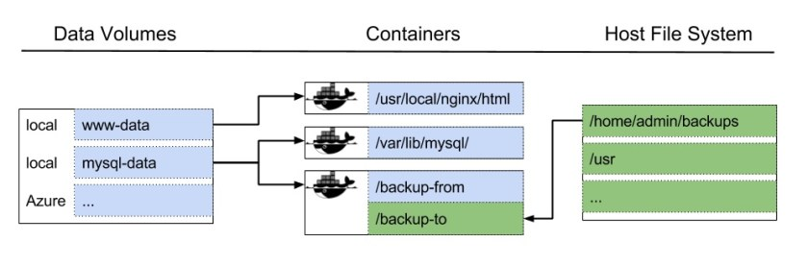
Volumes (Lab 2)
Volumes are the preferred mechanism for persisting data generated by and used by Docker containers
Docker volume is just a host directory mounted to container’s file system

Slide 5
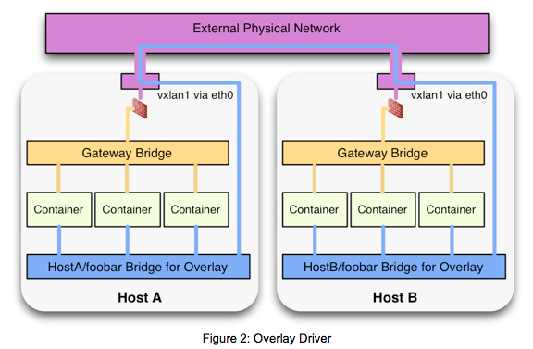
Networking (Lab-3)
Notes:
https://github.com/solarwinds/containers/tree/master/cnpt

Slide 6
Swarm (Lab-4)
Orchestration
Swarm
Swarm manager
Swarm worker
Notes:
ORCHESTRATION
Container orchestrators, such as Docker Swarm and Kubernetes, provide a ton of functionality around managing and deploying containerized applications. But the two most fundamental things they do are clustering and scheduling
If you heard about containers you've probably heard about orchestration as well. Container orchestrators, such as Docker Swarm and Kubernetes, provide a ton of functionality around managing and deploying containerized applications. But the two most fundamental things they do are clustering and scheduling (that's not all they do by a long shot, but they are arguably the two most important functions).Clustering is the concept of taking a group of machines and treating them as a single computing resource. These machines are capable of accepting any workload because they all offer the same capabilities. These clustered machines don't have to be running on the same infrastructure - they could be a mix of bare metal and VMs for instance. Scheduling is the process of deciding where a workload should reside. When an admin starts a new instance of website she can decide what region it needs to go on or if it should be on bare metal or in the cloud. The scheduler will make that happen. Schedulers also make sure that the application maintains its desired state. For example, if there were 10 copies of a web site running, and one of them crashed, the scheduler would know this and start up a new instance to take the failed one's place.
SWARM
Swarm is a group of machines that are running Docker and joined into a cluster
https://docs.docker.com/get-started/part4/#understanding-swarm-clusters
https://docs.docker.com/engine/swarm/#feature-highlights
https://docs.docker.com/engine/swarm/how-swarm-mode-works/services
Services are an abstraction in Docker that represent an application or component of an application. For instance a web front end service connecting to a database backend service. You can deploy an application made up of a single service.
The service construct provides a host of useful features including:
Load balancing* Layer 4 and layer 7 routing meshes
Desired state reconciliation
Service discovery
Helthchecks
Upgrades and rollback
Scaling
Swarm manager (Leader)
Manager nodes handle cluster management tasks:
maintaining cluster state
scheduling services
serving swarm mode HTTP API endpoints
Swarm worker
Worker nodes are also instances of Docker Engine whose sole purpose is to execute containers. Worker nodes don’t participate in the Raft distributed state, make scheduling decisions, or serve the swarm mode HTTP API.
https://docs.docker.com/engine/swarm/raft/

Slide 7
Container Network Performance Tool (Lab 5)
The tool is intended to educate and facilitate decision-making of which type of network (i.e. network driver) to deploy in a container cluster (a multi-host environment), whether container orchestration is present or not.
The tool facilitates comparison of the performance (via throughput test) of various container network plugins, producing a shareable throughput report. And assists in highlighting mishaps to avoid in your container network setup
Notes:
https://github.com/solarwinds/containers/tree/master/cnpt

